Slide 1

Simplify the Usage of Lexicon in Chinese NER
Minlong Peng, Ruotian Ma, Qi Zhang, Xuanjing Huang
Fudan University
ACL2020
2020.09.28

Slide 2

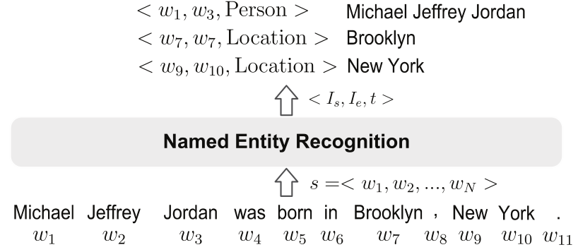
A Survey on Deep Learning for
Named Entity Recognition
Introduction
Named Entity Recognition (NER) aims to recognize mentions of rigid designators from text belonging to predefined semantic types such as person, location, organization etc.
Relation extraction
Information retrieval
Machine translation
Question answering
Recommender

Slide 3
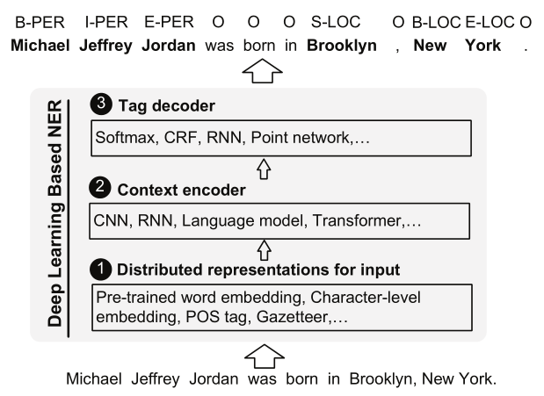
Introduction
Output Layer
Sequence Modeling Layer
Input Layer
Character-level
Word-level

Slide 4
Intention
Disadvantage
Lattice-LSTM still has missing information
Lattice-LSTM is inefficient and not suitable for actual scenarios and production environments
Lattice-LSTM is difficult to migrate
Approach
Lattice-LSTM
SoftLexicon

Slide 5
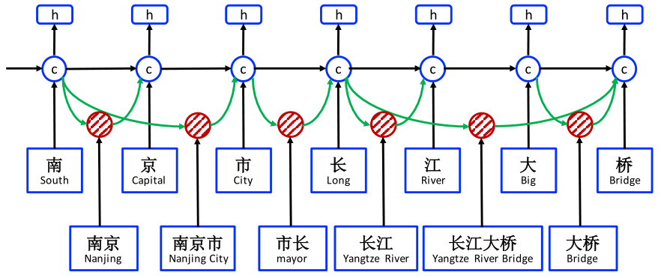

Lattice-LSTM still has missing information
Lattice-LSTM is inefficient and not suitable for actual scenarios and production environments
Lattice-LSTM is difficult to migrate

Slide 6
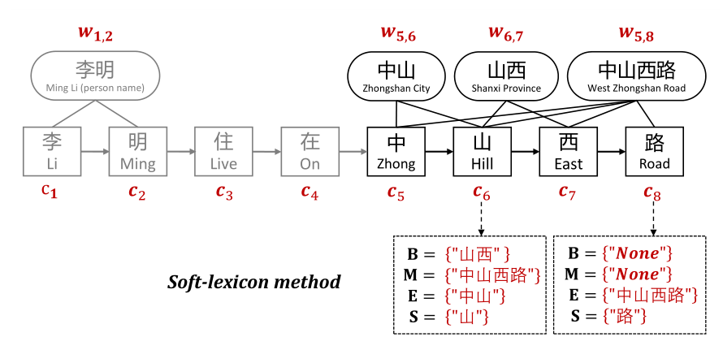
{B, M, E, S,}

Slide 7
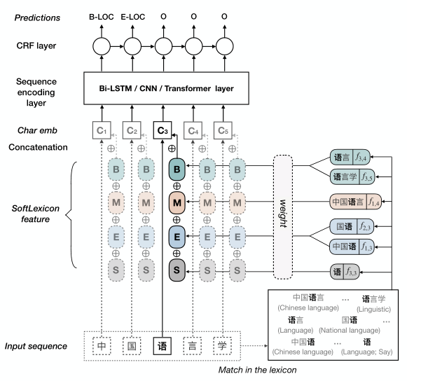
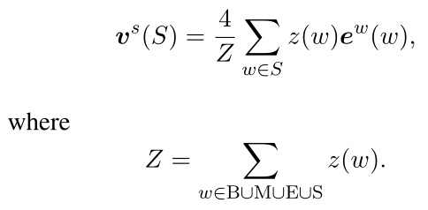
Model

Slide 8
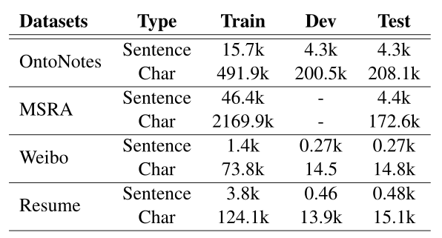
Experiments
Dataset
Notes:
本模型使用CSNER中文数据集进行实验验证:
CSNER数据集从中国知网收集的计算机领域数据，一共有四种实体类型，并且每个实体类型都有特定实体以及指代实体，具体的数据统计如表所示。
标注了共9248个实体
数据集的标准标注格式如右侧，每个字与标签中间以空格分割，句子之间以空行分开，微博数据集标签中会标明特定实体或指代实体类型。

Slide 9
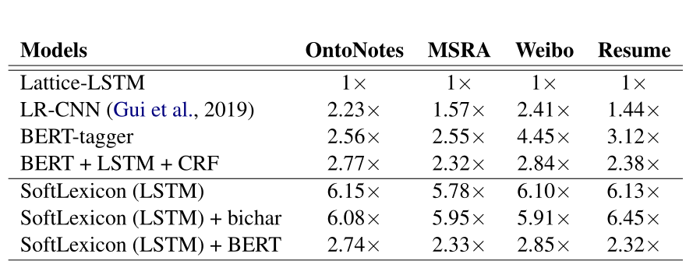
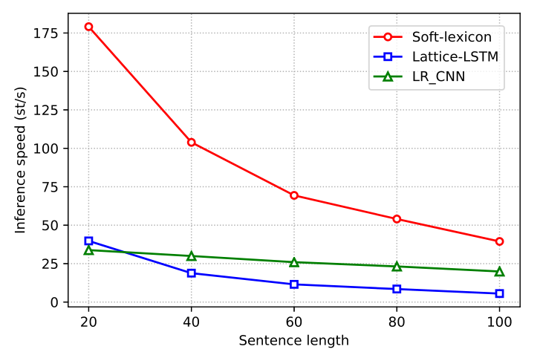
Experiments
Inference speed
Inference speed (average sentences per second,
the larger the better)
Notes:
对实验结果进行判定时，主要基于三个方面进行评判：准确对实体边界进行划分、实体类型分类正确、以及标注实体内部位置顺序正确。只有同时满足上述三个标准，才可认为该标签结果预测正确。
实验采用国内外评测会议公认的评价指标：准确率，召回率，以及F1值

Slide 10
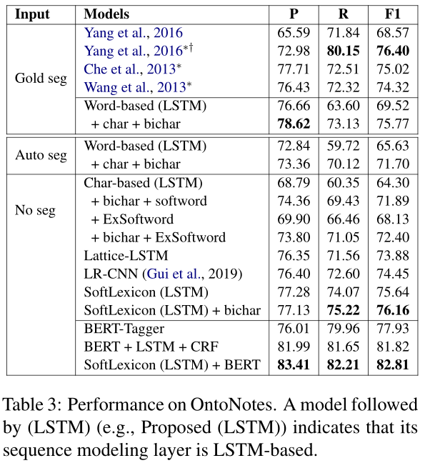
Experiments

Slide 11
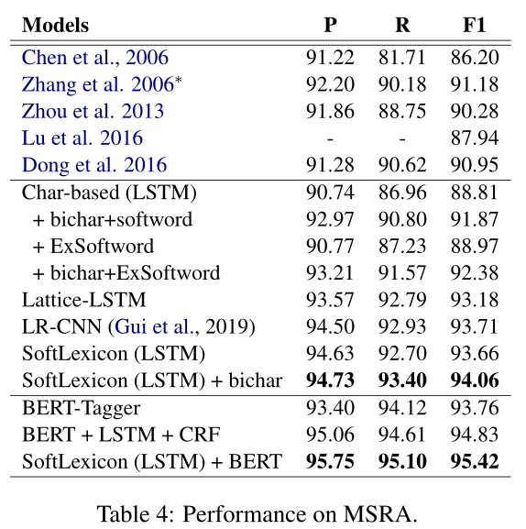
Experiments

Slide 12
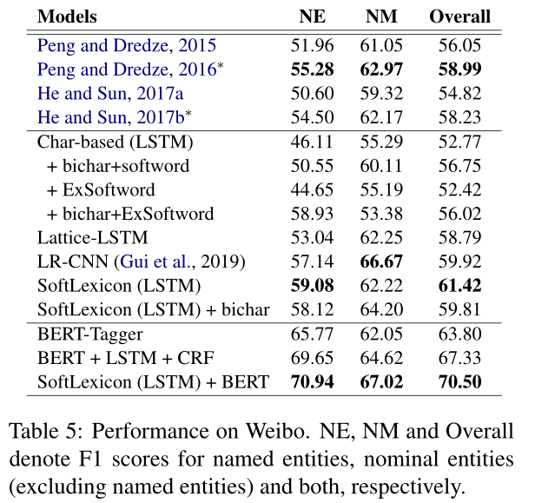
Experiments

Slide 13
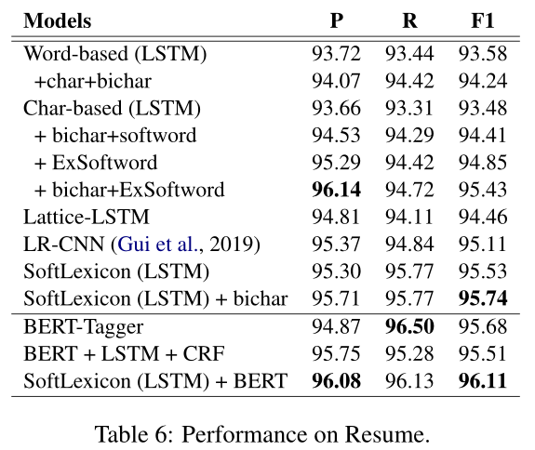
Experiments

Slide 14
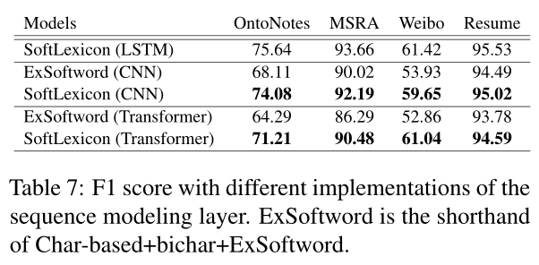
Experiments

Slide 15
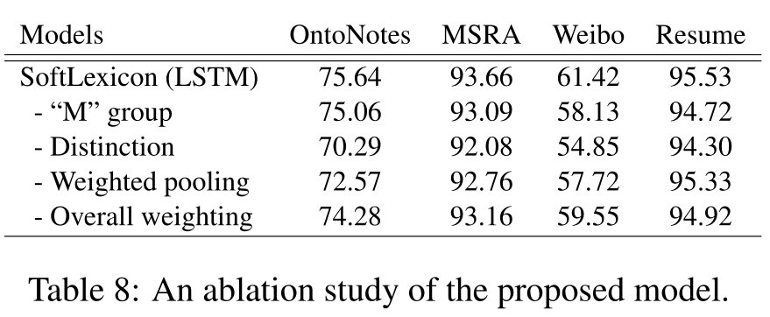
Experiments

Slide 16
Summary
work
Incorporate lexicon information into character representation layer.
实体类型与实体边界
Advantages
1.Avoid designing complicated model architecture.
2.Transferable to different sequence-labeling architecture. 3.Can be easily incorporated with pre-trained models.

Slide 17

Thank you
Notes:
以上就是今天的答辩内容，感谢各位老师同学们的聆听。谢谢

